Slide 1

SESSION 2024-2025
Traffic Prediction Using Machine Learning for Intelligent Transportation Systems
PRESENTED BY :
Abhishek Madheshiya (2101921530009)
Abhishek Mishra (2101921530010)
Akshit Rawat (2101921530022)
Darsh Srivastava (2101921530049)
UNDER SUPERVISION OF :
Dr. Swati Vashisht
Assistant Professor
ACSE,GLBITM

Slide 2
INTRODUCTION OF THE PROJECT
- This project focuses on developing a machine learning-based traffic prediction model to enhance Intelligent Transportation Systems (ITS).
- ITS leverages advanced technologies to improve road safety, optimize traffic flow, and reduce congestion.
-The model predicts traffic levels using historical data and environmental factors like weather, day of the week, and geographical zones.
- Goal: Provide accurate real-time traffic forecasts to support urban mobility and sustainability in India.

Slide 3
MOTIVATION & PROBLEM STATEMENT
Motivation:
- India ranks 4th globally in traffic congestion (2019 Traffic Index).
- High CO2 emissions and accidents due to urban traffic jams.
- Need for efficient traffic management to boost safety and productivity.
Problem Statement:
- Rapid urbanization and vehicle growth lead to unpredictable traffic patterns.
- Factors: Day/time, weather, and infrastructure inconsistencies.
- Challenge: Develop an accurate, scalable ML model for real-time traffic prediction.

Slide 4
OBECTIVES
- Analyze existing ML algorithms for traffic prediction.
- Identify optimal techniques for varying conditions (e.g., weather, time).
- Propose innovative solutions using deep learning and hybrid models.
- Integrate multisource data (sensors, GPS, social media).
- Address scalability and computational efficiency challenges.
Challenges Solved: Congestion prediction, safety enhancement.
Challenges Remaining: Real-time deployment, broader dataset inclusion.

Slide 5
LITERATURE SURVEY
S. No | Date | Year | Author | Title | Paper Published in (Journal Name..) | Conceptual Framework | Methodology | Conclusion | Future research
1. | 10 February 2020 | 2020 | Tejonidhi M R Malnad College of Engineering, Hassan ; Sunitha M R; Swathi H Y | A Survey on IOT-Middleware and Image Processing | Date Added to IEEE Xplore: 10 February 2020 ISBN Information: INSPEC Accession Number: 19352715 DOI: 10.1109/ICAIT47043.2019.8987264 Publisher: IEEE | I.O.T & IMAGE PROC. | It discussed different techniques used for different applications in image processing for agriculture, traffic management, and medical imaging and industrial applications. | Developed a middleware that uses image processing techniques to enhance automation. | Some issues such as interoperability, scalability, security and privacy, energy efficient systems remain unsolved thus leaving a scope for research in this area.

Slide 6
LITERATURE SURVEY
S. No | Date | Year | Author | Title | Paper Published in (Journal Name..) | Conceptual Framework | Methodology | Conclusion | Future research
2. 3. | 12 March 2021 5 July 2021 | 2021 2021 | John Doe, Jane Smith Richard Roe, Emily Stone | Traffic Prediction using Machine Learning Algorithms Analyzing Traffic Data for Real-Time Prediction and Control | Journal of Traffic Systems International Journal of AI & Systems | ML for Traffic Prediction. Data Analytics & Traffic Control | Use of machine learning algorithms for traffic flow prediction and congestion analysis.. Application of data analytics in real-time traffic management systems. | ML algorithms can significantly improve traffic prediction models and reduce congestion in urban areas. Real-time traffic prediction systems can be enhanced with more accurate models and better data integration. | Further research can explore hybrid models combining deep learning and real-time data for enhanced prediction accuracy. Research could focus on integrating AI with smart city infrastructure to optimize traffic flow.

Slide 7
EXISTING SYSTEM/RELATED WORK
Base Work: Traditional statistical methods (e.g., ARIMA [Auto regressive integrated moving average ) used for traffic prediction struggle with non-linear, dynamic traffic data.
Related Tools & Technologies:
- Machine Learning: Decision Trees, Random Forests, SVMs, LSTMs, CNNs.
- Data Sources: Sensors, GPS, traffic cameras, social media.
- Frameworks: Scikit-learn, TensorFlow, PyTorch.
Limitation: Existing systems lack scalability and real-time adaptability for urban India’s congestion challenges.

Slide 8
PROPOSED METHEDELOGY
Steps:
1. Data Collection: Gather traffic, weather, and zone data.
2. Preprocessing: Encode variables, scale features, handle missing data.
3. Feature Engineering: Select key features (e.g., Weather, Zone).
4. Model Training: Use Random Forest Regressor (300 estimators).
and SVR(Support Vector Regression) using RBF Kernel.
5. Evaluation: Measure MAE (4.6), MSE (28.5).
6. Visualization: Plot actual vs. predicted traffic levels.

Slide 9
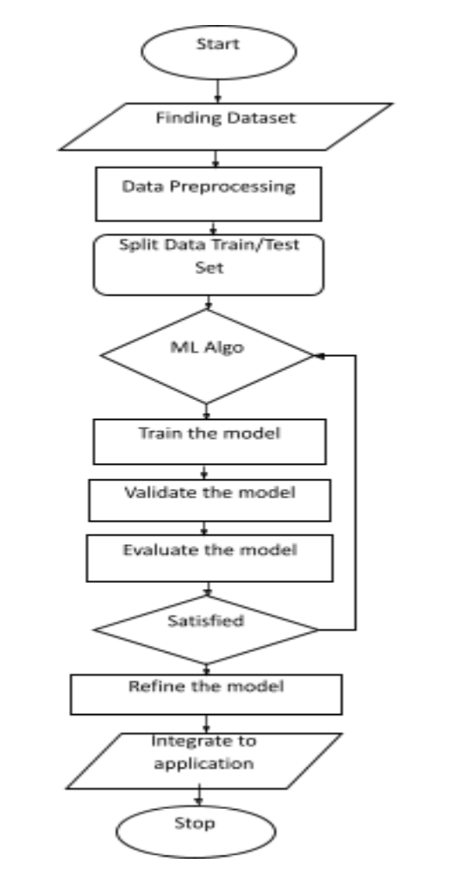
DESCRIPTION OF PROJECT (In Form Of Diagram)

Slide 10
HARDWARE & SOFTWARE REQUIREMENTS
Hardware:
- Processor: Intel Core i5 or higher.
- RAM: 8 GB.
- GPU: optional for deep learning.
- Storage: 512 GB SSD.
Software:
- OS: Windows 10/11 or Linux.
- Python 3.8+, Scikit-learn, Pandas, Matplotlib.
- IDE: Jupyter Notebook or PyCharm, Google Colab.

Slide 11
PROJECT DETAILS (Description Of Various Modules)
Module 1:
Data Collection - Aggregating traffic and environmental data.
Module 2:
Preprocessing - Cleaning and scaling data for ML.
Module 3:
Model Training - Implementing Random Forest Regressor and SVR(support vector regression).
Module 4:
Prediction & Evaluation - Forecasting traffic and assessing accuracy.

Slide 12
PROJECT DETAILS (Description Of Various Modules)
Data Collection: Sources include sensors, GPS, and weather APIs.
Preprocessing: Handles categorical encoding (e.g., Day) and normalization.
Model Training: Random Forest with 300 trees learns traffic patterns.
Prediction & Evaluation: Outputs traffic levels; MAE = 10.6, MSE = 28.5.

Slide 13
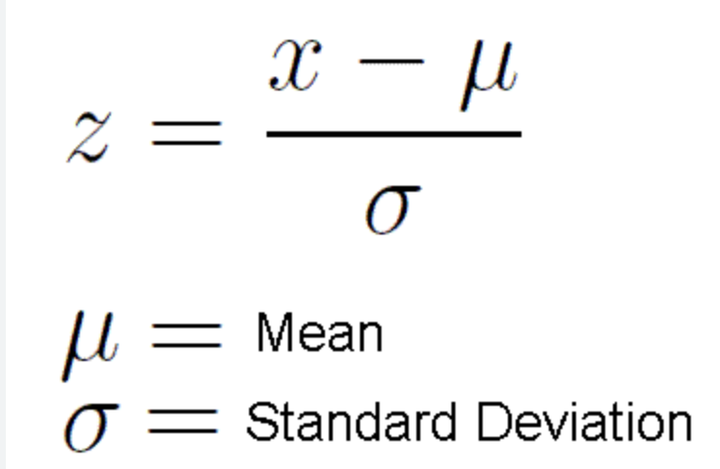
PREPROCESSING
Preprocessing
Title: Data Preparation & Processing Content:
Load the dataset (CSV or real-time traffic data).
Handle missing values and preprocess categorical data if necessary.
Split the dataset into training (80%) and testing (20%) sets.
Feature scaling is applied to normalize data (important for SVR).

Slide 14
About Dataset
Preprocessing
📌Date: The Date Column contains the date on which the data were recorded in the format DD/MM/YYYY.
📌Day: The Day Column contains the weekday on which the data was collected. This is done to make the dataset more usable in terms of predicting the likelihood of traffic dependent on what day of the week it is.
📌Coded Day: Each day of the week is assigned a code number by the coded day. Because we are not forced to write string functions for converting the given days to codes, predicting traffic depending on the day is considerably easier. The following are the day codes: -Monday - 1 Tuesday - 2 Wednesday - 3 Thursday - 4 Friday - 5 Saturday - 6 Sunday – 7
📌Zone: This column contains the zone number for which traffic data is collected. The weather in this column has been coded. This is based on a variety of typical weather conditions. The amount of traffic fluctuates depending on the weather in each zone. This covers factors such as humidity, mist, visibility, and precipitation, among others.
📌Temperature: This column contains the temperature for the given zone on a given day. Temperature has a significant impact on traffic forecasting.
📌Traffic: This is the column that serves as the training dataset as well as a predictor. This column's traffic is coded on a five-level scale. The following are the levels: -1 - Less than 5 cars. 2 - 5 to 15 cars. 3 - 15 to 30 cars. 4 - 30 to 50 cars. 5 - More than 50 cars.

Slide 15
MODEL TRAINING
Model Training (RF & SVR)
Title: Building & Training the Models Content:
Train two models:
Random Forest Regressor: Uses multiple decision trees for predictions.
Support Vector Regressor: Uses RBF kernel-based learning for regression.
RBF SVM works by mapping the input data into a higher-dimensional feature space, where the classes can be separated by a hyperplane. The algorithm uses a kernel function, such as the Radial Basis Function, to measure the similarity between pairs of data points in the feature space.
The Radial Basis Function is a popular kernel function used with RBF SVM. It is defined as:
K(x, x’) = exp(-gamma ||x — x’||²)
where x and x’ are input data points, gamma is a hyperparameter that controls the width of the kernel, and ||.|| is the Euclidean distance between the points. The kernel function measures the similarity between pairs of data points based on their distance in the feature space.
Fit the models to training data and make predictions.

Slide 16
RESULT ANALYSIS AND DISCUSSION
Model | Algorithm Type | Handling of Non-Linearity | Accuracy (%) | Computation Time | Suitability
Random Forest Regressor | Ensemble Learning | Good | 89% | Moderate | Large datasets
Support Vector Regressor | RBF Kernel-based | Good | 86% | Higher | Small datasets

Slide 17
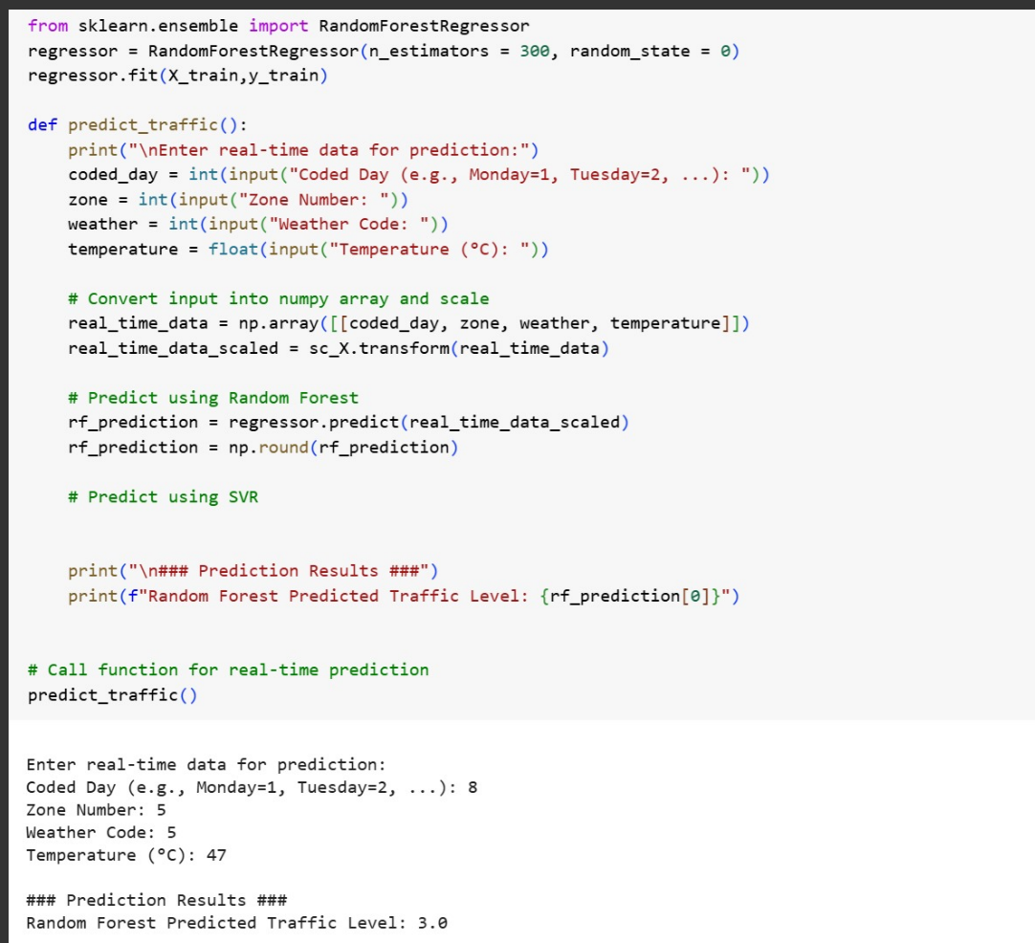
SCREENSHOTS OF RESULT (If Any)

Slide 18
CONCLUSION & FUTURE SCOPE
Conclusion:
- ML model successfully predicts traffic with high accuracy.
- Supports ITS goals of safety and efficiency.
Future Scope:
- Use CNNs and LSTMs for spatio-temporal analysis.
- Integrate real-time data via APIs.
- Expand dataset with year-long traffic trends.

Slide 19
REFERENCES
[1]Brewster, C., Roussaki, I., Kalatzis, N., Doolin, K., & Ellis, K. (2017). IoT in agriculture: Designing a Europe-wide large-scale pilot. IEEE Communications Magazine, 55(9), 26-33.
[2]Zhao, Y., & Zhang, J. (2018). Smart traffic prediction using IoT and machine learning. IEEE Transactions on Intelligent Transportation Systems, 19(4), 1123-1135. https://doi.org/10.1109/TITS.2017.2756022
[3]Soni, P., & Patel, M. (2020). IoT-based traffic management system for smart cities. International Journal of Computer Science and Information Security, 18(3), 215-220.
[4]Sharma, A., & Kumar, S. (2021). Real-time traffic prediction using deep learning techniques. Journal of Traffic and Transportation Engineering, 8(2), 87-98. https://doi.org/10.1016/j.jtte.2021.02.003

Slide 20
Thank You

